Slide 1
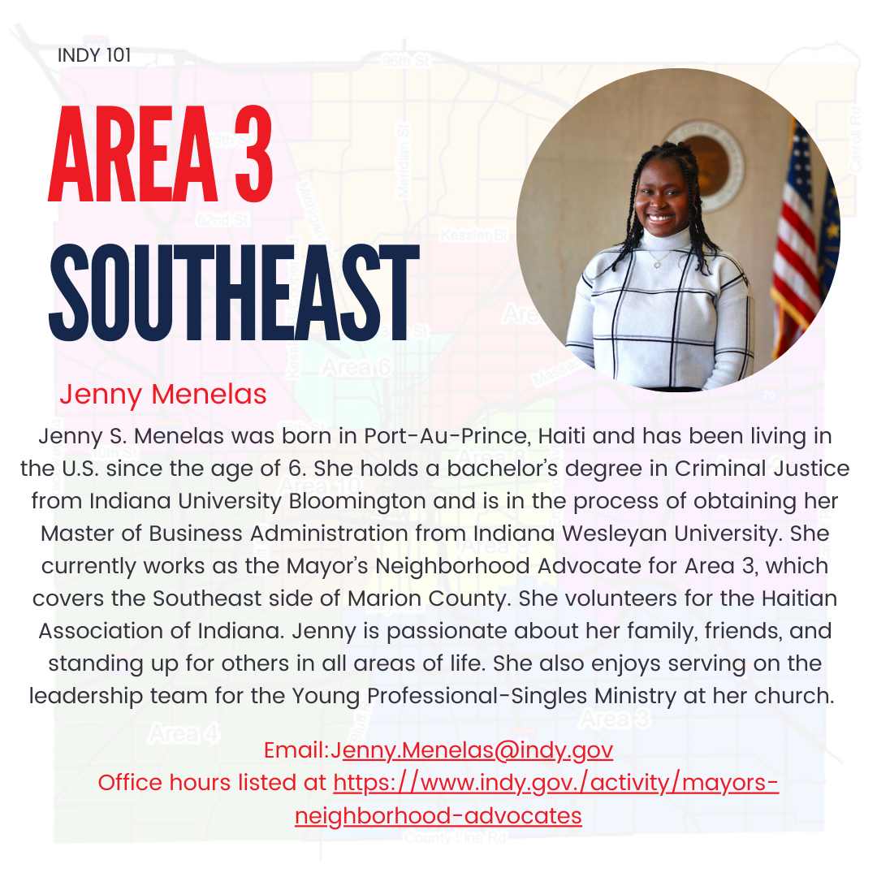
MNA – Jenny Menelas
CONTACT ME:
Jenny.Menelas@indy.gov

Slide 2
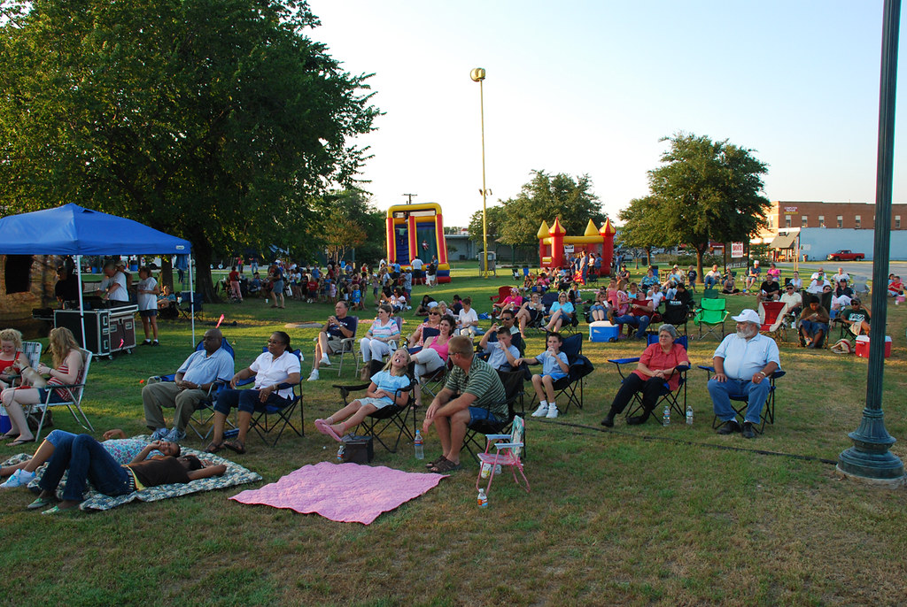
Indy Parks
Garfield Park Concerts
August 28 at 7pm – POPs
Broad Ripple Park Concerts
August 23 at 7pm – Cathy Morris
Sept. 20 at 7pm – The Half Step Sisters
Riverside Park Concerts
August 22 at 7:30pm – Psyrn Simone
August 23 at 7:30pm – Huckleberry Funk
August 29 at 7:30pm – Premium Blend
August 30 at 7:30pm – Be On It
Watkins Park Concerts
August 25 at 5pm – MUSICBOX Lester Johnson
Sept. 8 at 5pm – Sandy Lomax
This Photo by Unknown Author is licensed under CC BY-NC

Slide 3
Mayor Joe Hogsett Prosecutor Mears Recorder Faith Kimbrough Sheriff Forestal

Slide 4
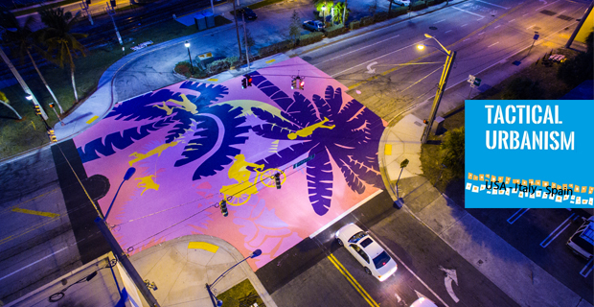
DPW
Community Powered Infrastructure
TACTICAL URBANISM
a program that allows communities to test infrastructure changes in their neighborhood through low-cost, temporary projects
ART IN THE RIGHT OF WAY
Art in the Right-of-Way is a program that allows communities to celebrate their unique identities by using art within the City right-of-way for placemaking within their neighborhoods
DEADLINE: August 30th
50/50 cost share

Slide 5
ACS
In 2025 Budget: Proposal 256-Amends the code to create the independent Animal Care Services Agency
-Creation of an independent Animal Care Services Agency
-Elevates animal welfare staff and services within the City-County enterprise
-Frees up Business and Neighborhood Services leadership to focus their entire attention on improving services like licensing, permitting, and inspections
-Increased funding for supplies to reduce agency’s reliance on donors
-Funding for professional kennel cleaning to free up staff time to focus on animal care, adoptions, and improving best practices

Slide 6
Budget Proposal
Funding the Clinician Led Community Response team in the east and downtown IMPD districts
Creation of a safety ambassador position for Parks to begin developing a program dedicated to enhanced public safety in parks
$199.6 million for roads, bridges, and greenway improvements across Indianapolis neighborhoods in 2025
$68.4 million for storm water systems improvements across Indianapolis neighborhoods in 2025
$1 million to each councilor for a DPW or Parks project

